Slide 1

Rental Housing Project
By – Group 4
September 2020

Slide 2
Outline
Introduction
Problem Description
Use Case Diagram
Class Diagram
Sequence Diagram
Development
Sample UI

Slide 3

Introduction
It is difficult to find a house or an apartment to rent.
we want to solve this problem by creating a Rental Housing System.
the system will let a user
create an account log in
look for a house to rent
search for an apartment
rent an apartment
add an apartment

Slide 4
Problem Description
User
Apartment
Apartment Address
Rented Apartment
Favorite Apartment
Apartment Feature
Admin

Slide 5
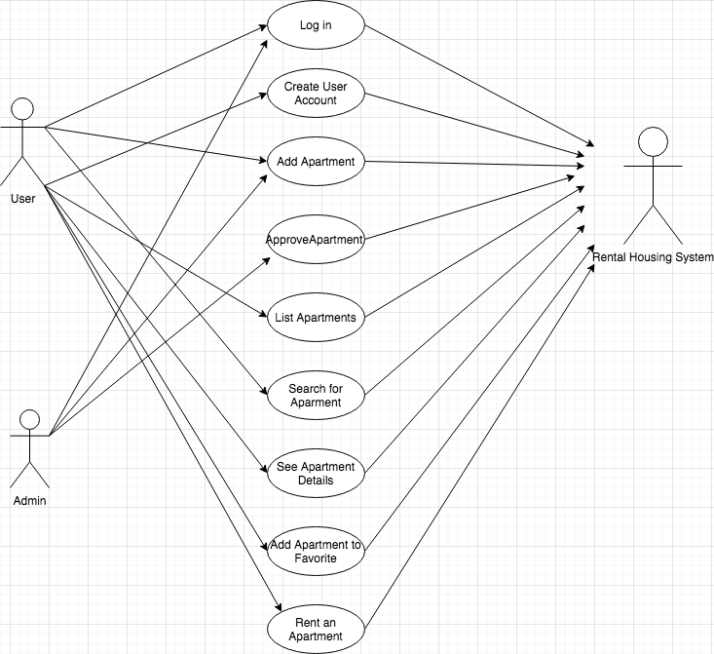
Use Case

Slide 6
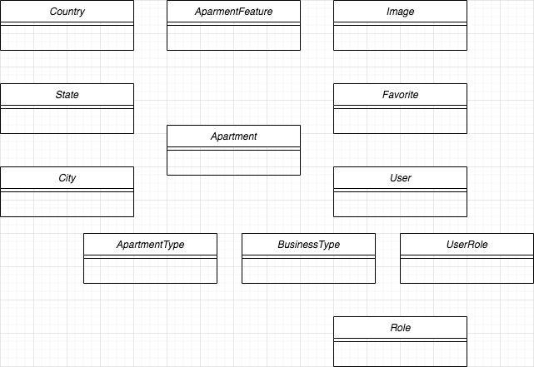
Class Diagram – Key Abstraction

Slide 7
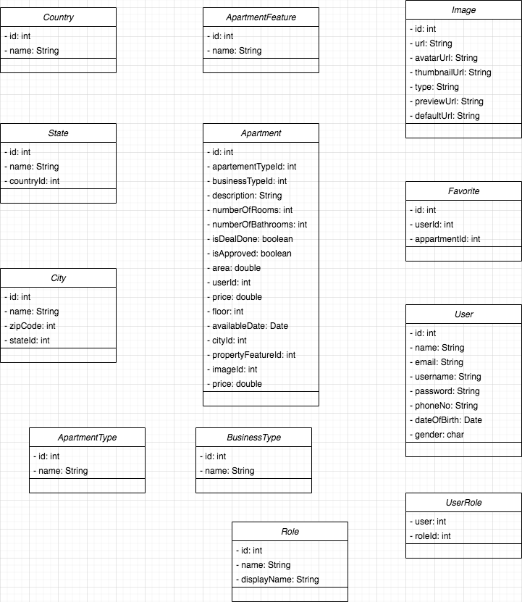
Class Diagram – Without Relationship

Slide 8
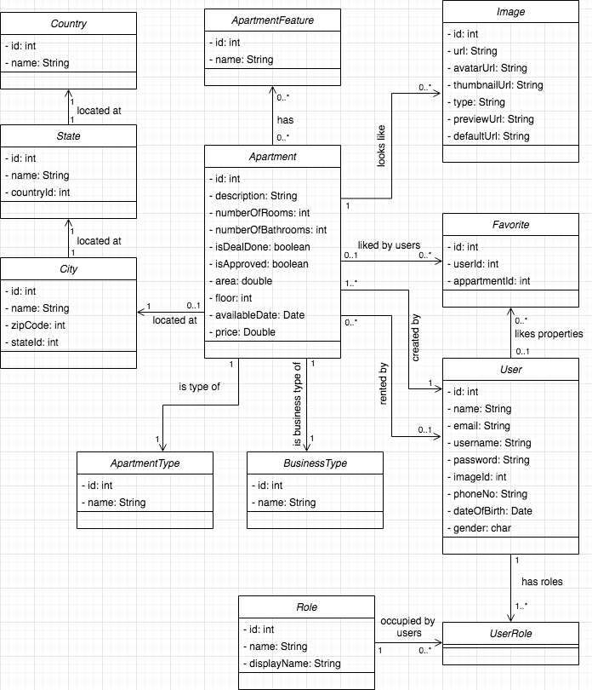
Class Diagram – Without Operation

Slide 9
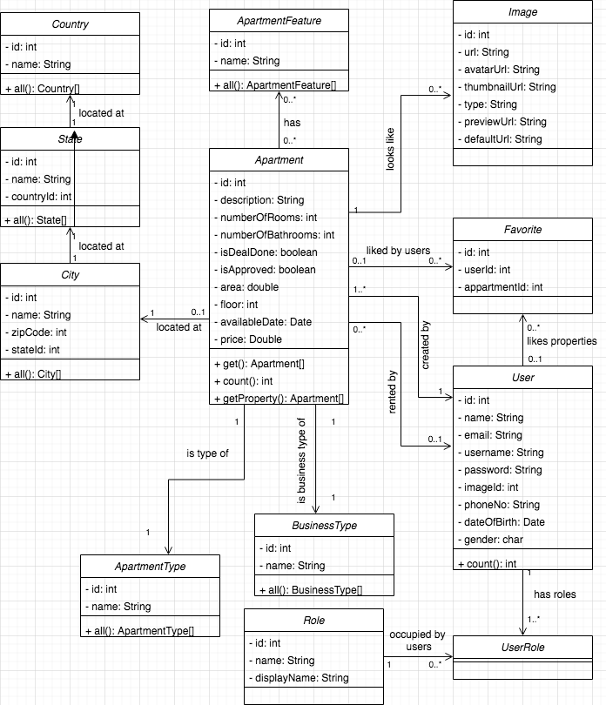
Class Diagram – Final

Slide 10
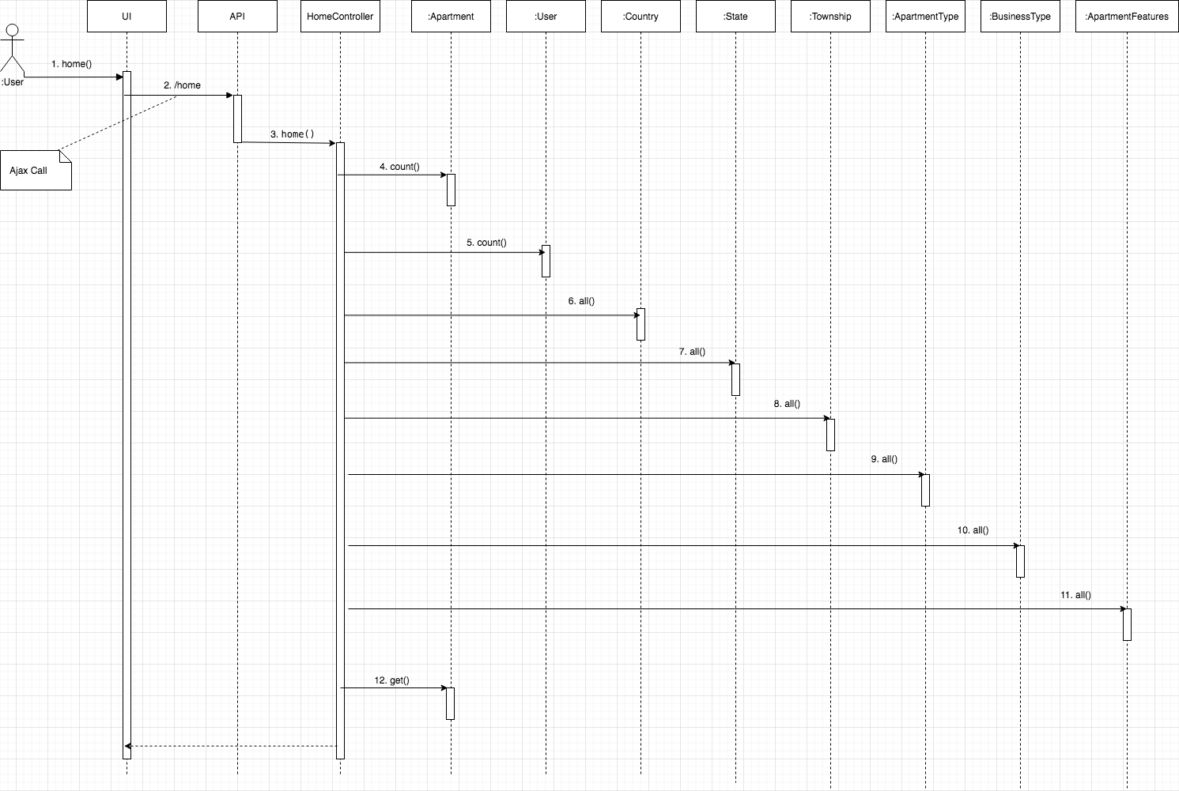
Sequence Diagram - Home

Slide 11
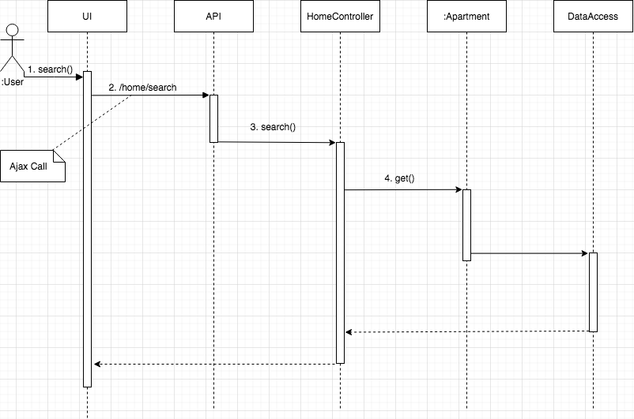
Sequence Diagram - Search

Slide 12
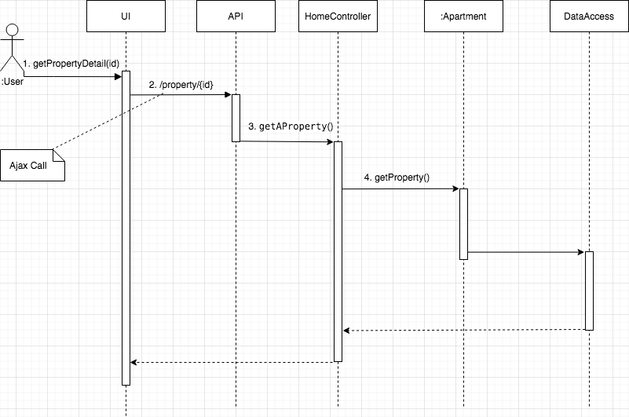
Sequence Diagram – Apartment Detail

Slide 13
Development
Data Access
MySql Database
Back-End
PHP – Laravel
Front-End
HTML, CSS, JavaScript, AJAX, JQuery

Slide 14
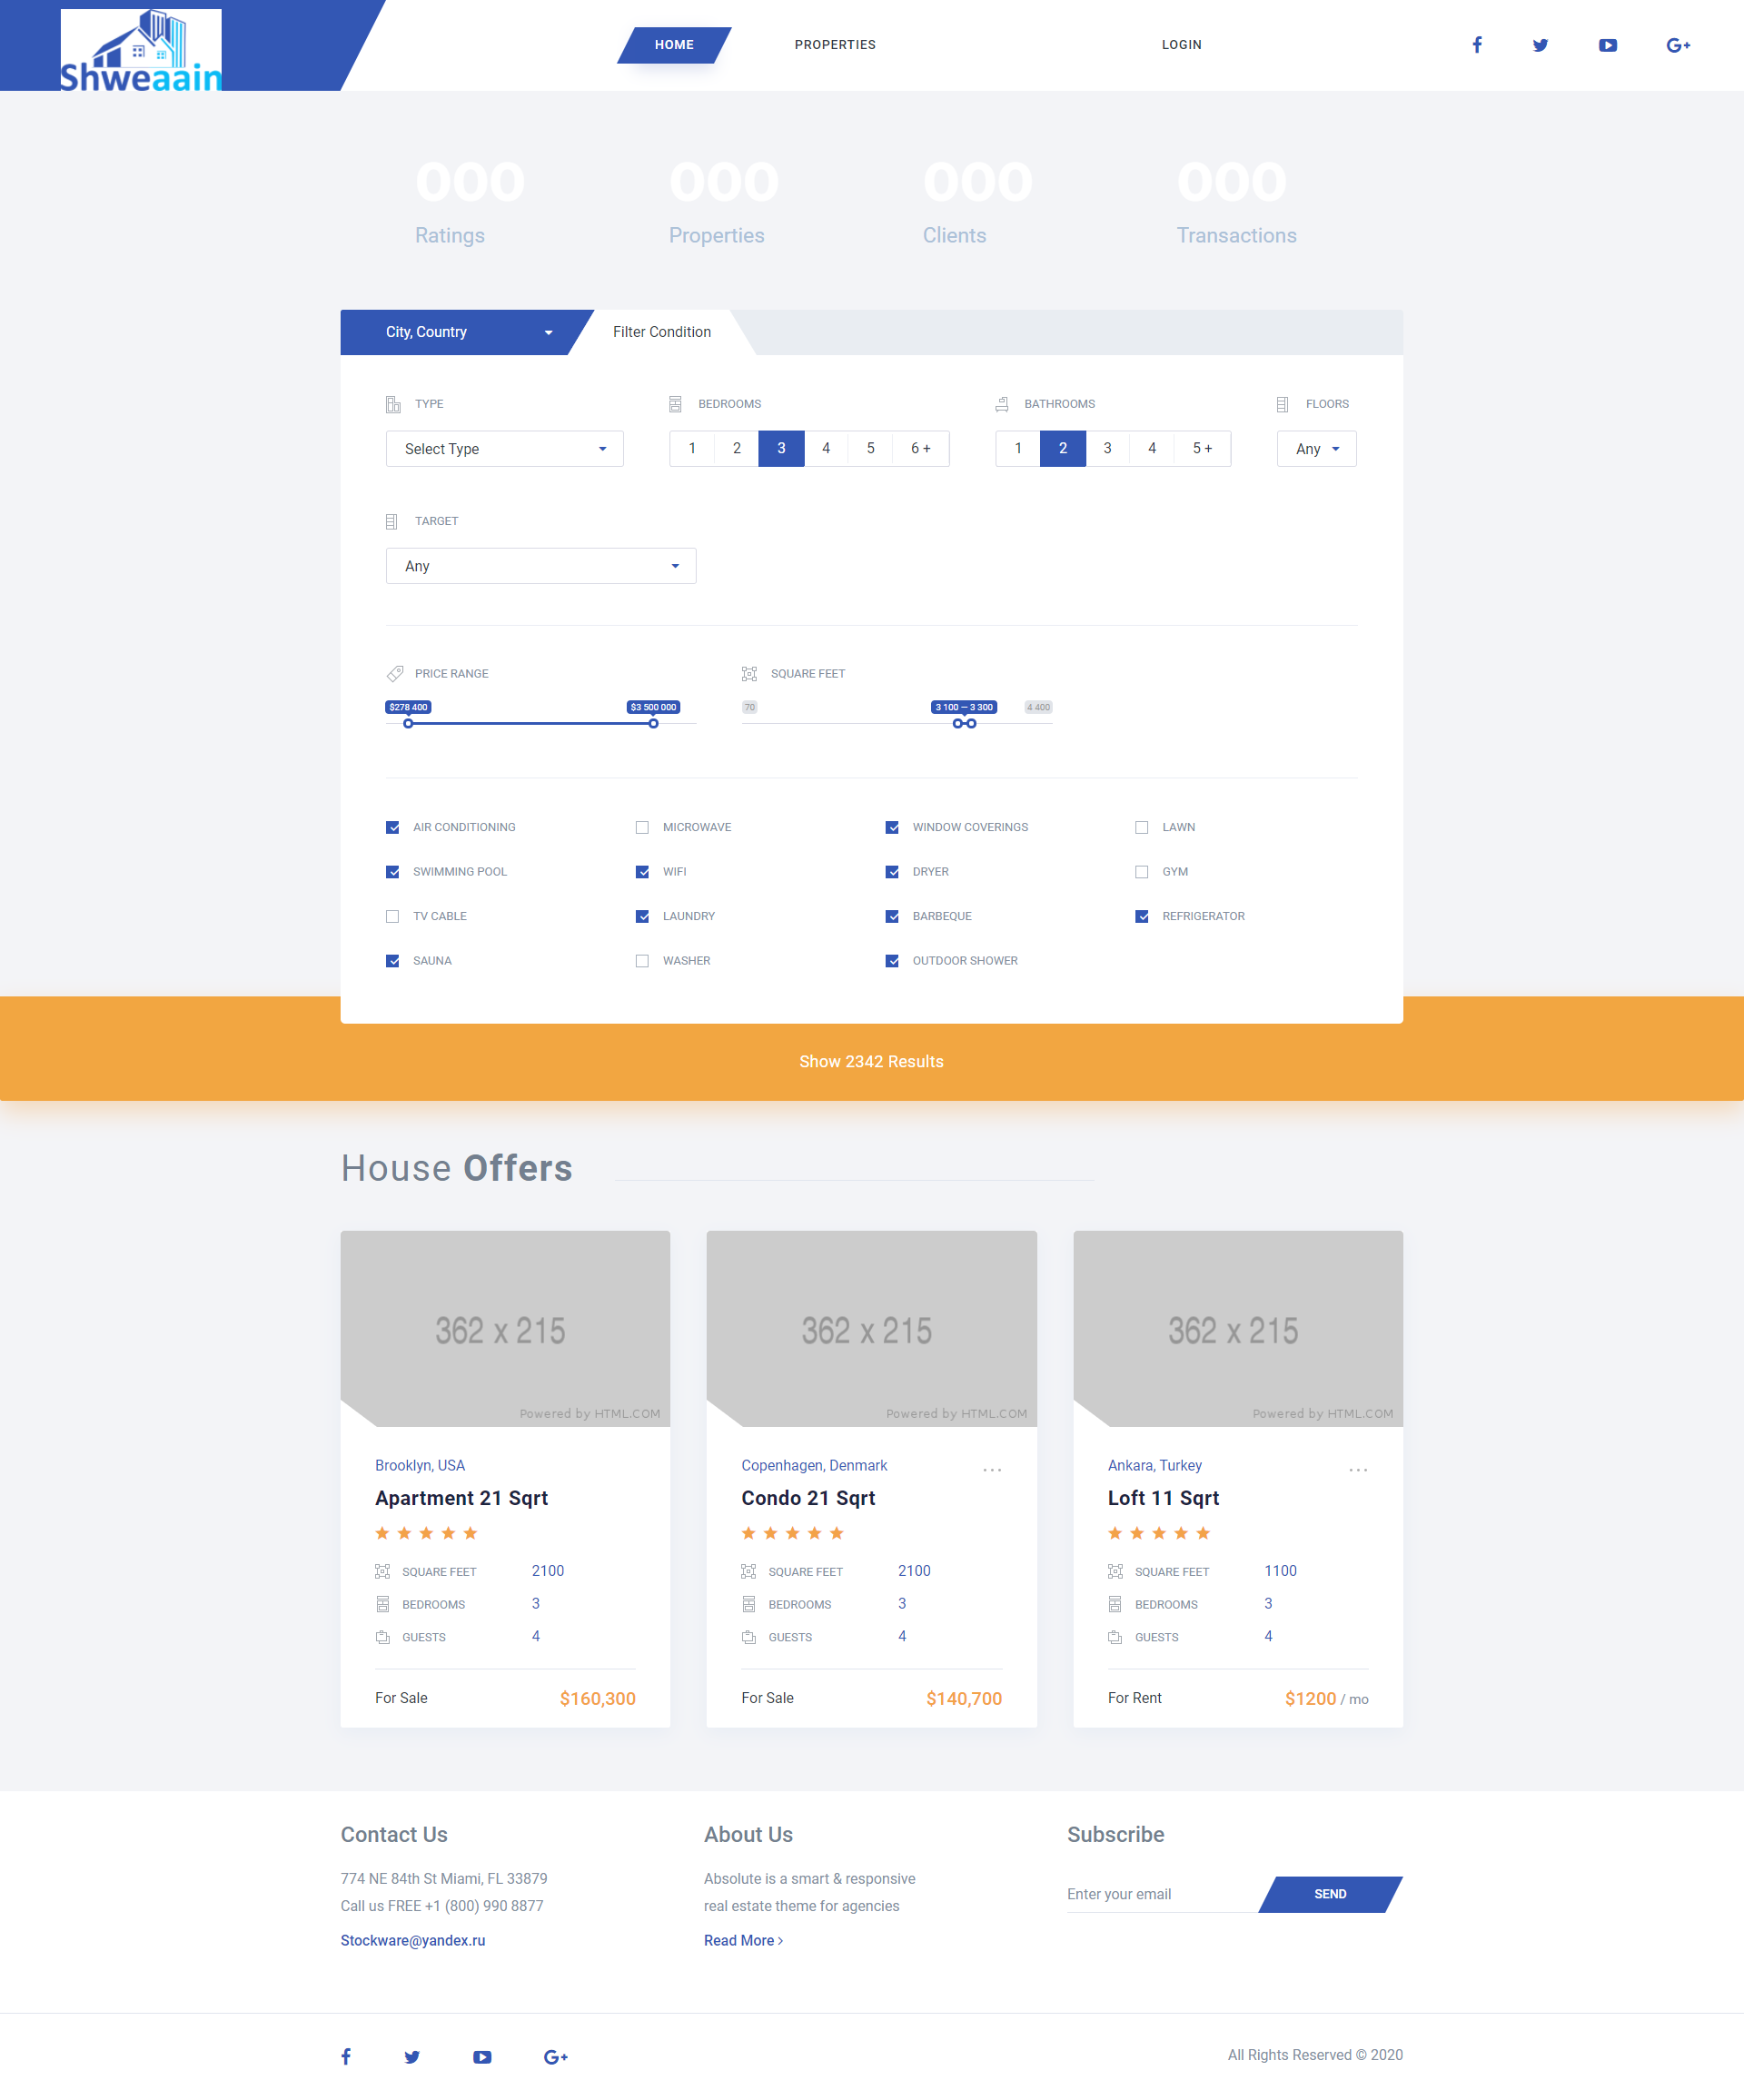
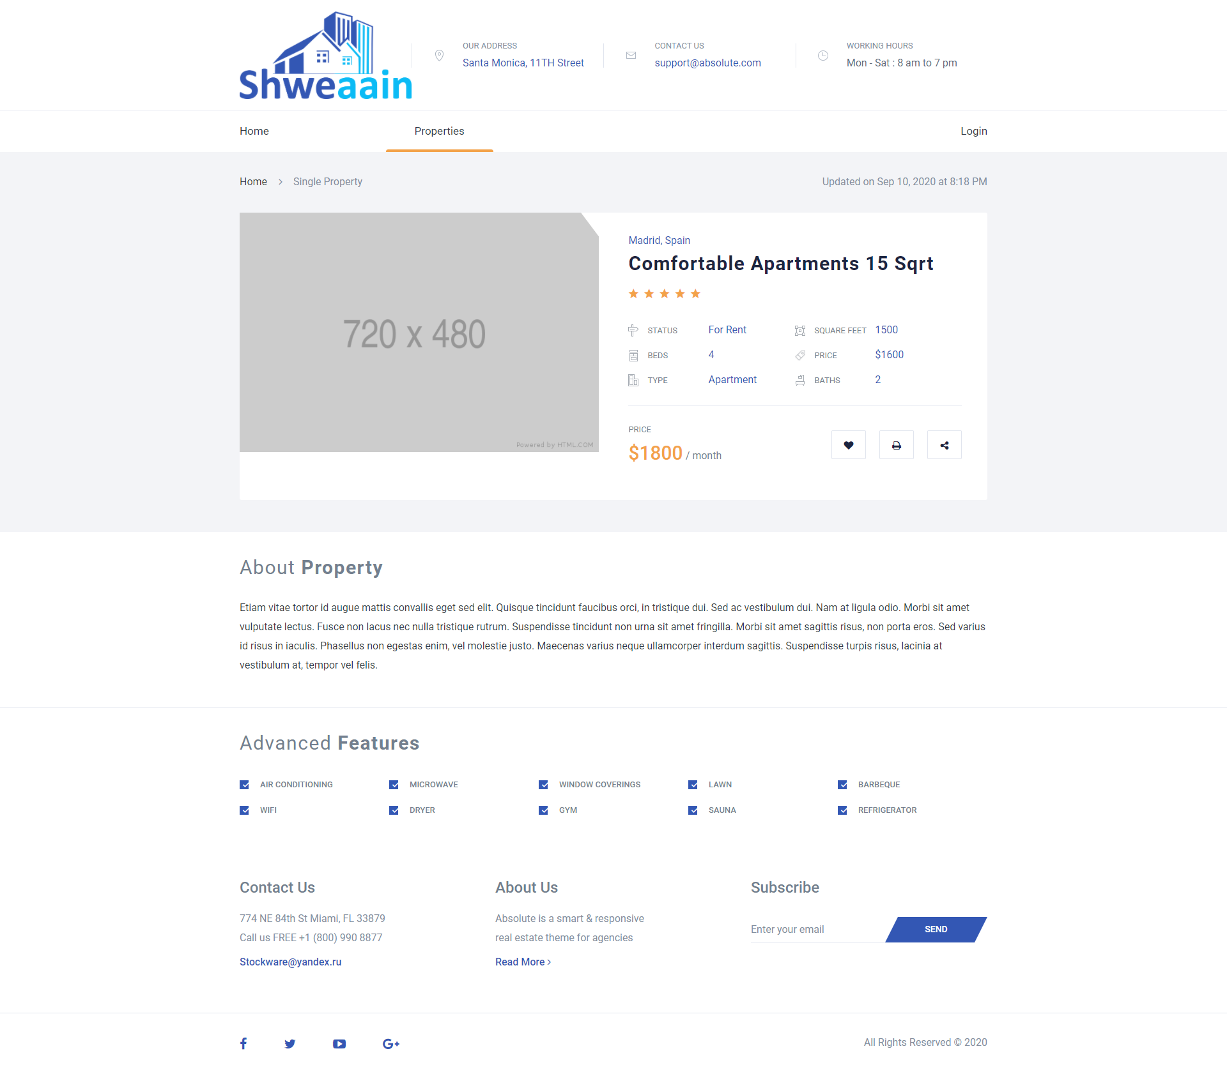
Sample UI

Slide 15
Thank you

